Slide 1
S.Y.B.Sc.(DATA Science) Sem- III Subject: Data Structure – I Unit1 : Introduction to Data Structures and Algorithm Analysis
By,
Mrs. Reshma Masurekar
Dr. D. Y. Patil ACS College,
Pimpri, Pune 18.

Slide 2
Unit1 : Introduction to Data Structures and Algorithm Analysis
Overview of Data Structure
Need of Data Structure,
Definitions: Data and information, Data type, Data object, ADT, Data Structure
Types of Data Structures: Linear vs NonLinear, Static vs. Dynamic
Complexity Analysis
Space and time complexity
Asymptotic notations (Big O, Omega Ω, Theta  ),
Best, Worst, Average case analysis

Slide 3
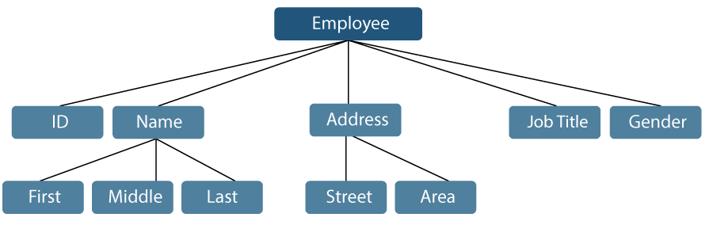
Data
Data: Raw, unprocessed facts, figures, or symbols that can be processed and analyzed to extract useful information. Data can be numerical, textual, or even visual.
Data is a Piece of Information.
Example: Employee name can be broken down into three sub-items: First, Middle, and Last. However, an ID assigned to an employee will generally be considered a single item.

Slide 4
Types of Data
Data is divided into atomic and non-atomic data:
Atomic data:
It is single or non-decomposable entity. Data cannot be broken into subfields.
Ex.: EmployeeId
2. Non-atomic data:
Data can be broken into subfields.
It is also called as structured data or Composite data.
Ex.: EmployeeName
EmployeeName is divided into Fname, Mname, Lname

Slide 5
Information
Information: Data that has been processed, organized, and presented in a meaningful way to provide context and allow for informed decision-making.
Information is defined as meaningful, logical and processed data.
Data are raw facts from which the required information is produced.
Information_1
Information_2
.
.
.
Information_n
Procedure to process data
Data

Slide 6
Data Types
Data type is used to describe the type of data that variable may hold in the programming language.
Data type=Permitted data values + operations
Data type is also defined as set of values and set of operations that operate on those values.

Slide 7
Data object
A data object represents a container for data values – a place where data values are stored and later retrieved. OR
A storage location containing a value or group of values that can be accessed using an identifier or a complex expression.
Data objects refers to the set of all elements say D, which may be finite or infinite.
Ex.: The data object of “alphabet” is defined as :
D={A, B,….Z}
Ex.: The data object of “integer” is defined as :
D={….-2,-1,0,1,2,….}
Data object is binded with type, location, value, name & component.

Slide 8
ADT
concept or model of a data type that defines its behavior and operations independently of how it is implemented. ADTs focus on the what (the data and its operations) rather than the how (the implementation details).
Abstract Data type (ADT) specifies a set of data and set of operations that can be operated on that data.
The definition of ADT only mentions what operations are to be performed but not how these operations will be implemented.
It does not specify how data will be organized in memory and what algorithms will be used for implementing the operations.
It is called “abstract” because it gives an implementation-independent view.
ADT acts as blackbox.
Ex. :List ADT, Stack ADT, Queue ADT

Slide 9
Advantages of ADT
Encapsulation: It ensures that data cannot be corrupted.
Reusability: ADT is reusable and ensures robust data structure.
It reduces coding efforts.
Hiding Implementation details.
ADT is useful guidelines to implement and a useful tool for programmers who wish to use the data type correctly.

Slide 10
Data Structure
A data structure is a storage that is used to store and organize data. It is a way of arranging data on a computer so that it can be accessed and updated efficiently.
Data Structure is used for organizing the data in memory.
There are various ways of organizing the data in the memory, like array, list, stack, queue, and many more.
The data structure isn’t a programming language like C, C++, Java, etc. It is a set of algorithms that can be used in any programming language to organize the data in the memory.

Slide 11
Need of Data Structure
Data structure modification is easy.
It requires less time.
Save storage memory space.
Data representation is easy.
Easy access to the large database.

Slide 12
Need of Data Structure
As applications are becoming more complex and the amount of data is increasing day by day, which may cause problems with processing speed, searching data, handling multiple requests etc.
Data structure provides a way of organizing, managing, and storing data efficiently. With the help of data structure, the data items can be traversed easily. Data structure provides efficiency, reusability and abstraction. It plays an important role in enhancing the performance of a program because the main function of the program is to store and retrieve the user’s data as fast as possible.

Slide 13
Introduction to Data Structure
It is a programming construct to implement an ADT.
It is the physical implementation of ADT.
A DS that is implementing as ADT contains collection of variables for storing the data specified in ADT and the algorithms for implementing the operations specified in ADT.

Slide 14
Data Structure
Data structure is a way of collecting and organizing data in such a way that operations can be performed on these data in an efficient way.
Logical or mathematical model of a particular organization of data in main memory is called as a data structure.
A data structure is defined as, a set of domains D, a designated domain ε D(belongs to D), a set of functions F, and a se of axioms A. The triple(D,F,A) denotes the data structure d and it will usually have written as d, where,
Domain(D): Denotes data object.
Function(F): Denotes the set of operations that can be performed on the data objects
Axioms(A): Denotes the properties and rules of the operation.

Slide 15
Operations on Data Structure
Some common operations performed on Data Structure
Insertion
Deletion
Traversal
Search

Slide 16
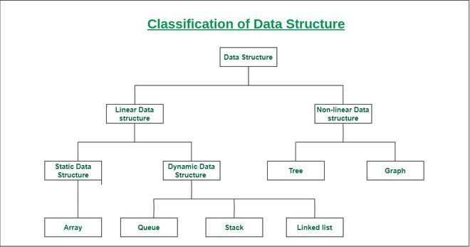

Slide 17
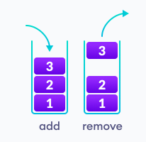
Linear data structure
Data structure is said to be linear if data elements are arranged sequentially.
Each element is attached to its previous and next adjacent elements.
Examples: array, stack, queue, linked list, etc.

Slide 18
Static data structure: Static data structure has a fixed memory size. It is easier to access the elements in a static data structure. Example: array
Dynamic data structure: In the dynamic data structure, the size is not fixed. It can be randomly updated during the runtime which may be considered efficient concerning the memory (space) complexity of the code. Example: queue, stack, etc.

Slide 19
Non-Linear data structure
Data structure is said to be Non-linear if its elements form a hierarchical classification where data elements are appears at various level.
we can’t traverse all the elements in a single run only.
Example: Tree, Graph

Slide 20
Linear Data Structures | Non Linear Data Structures
The data items are arranged in sequential order, one after the other. | The data items are arranged in non-sequential order (hierarchical manner).
All the items are present on the single layer. | The data items are present at different layers.
It can be traversed on a single run. That is, if we start from the first element, we can traverse all the elements sequentially in a single pass. | It requires multiple runs. That is, if we start from the first element it might not be possible to traverse all the elements in a single pass.
The memory utilization is not efficient. | Different structures utilize memory in different efficient ways depending on the need.
The time complexity increase with the data size. | Time complexity remains the same.
Example: Arrays, Stack, Queue | Example: Tree, Graph, Map

